Slide 1

PySpark Using Python
Submitted by:
Aizaz Khan
Submitted to:
Sir Dr Imran Mughal

Slide 2

What is spark
Feature of Apache spark
Pyspark RDD
Apache spark Ecosystem
Spark case study
Real_life Usage of pyspark
How to install and run Pyspark in jupyter Not book on windows

Slide 3
What is Apache spark
Apache Spark is an open-source distributed cluster-computing framework introduced by Apache Software Foundation.
It is a general engine for big data analysis, processing and computation. It is built for high speed, ease of use, offers simplicity, stream analysis and run virtually anywhere.
It can analyze data in real-time. It provides fast computation over the big data.
The fast computation means that it's faster than previous approaches to work with Big Data such as MapReduce.
The main feature of Apache Spark is its in-memory cluster computing that enhances the processing speed of an application.
It can be used for multiple things like running distributed SQL, creating data pipelines, ingesting data into a database, running Machine Learning algorithms, working with graphs or data streams, and many more.

Slide 4
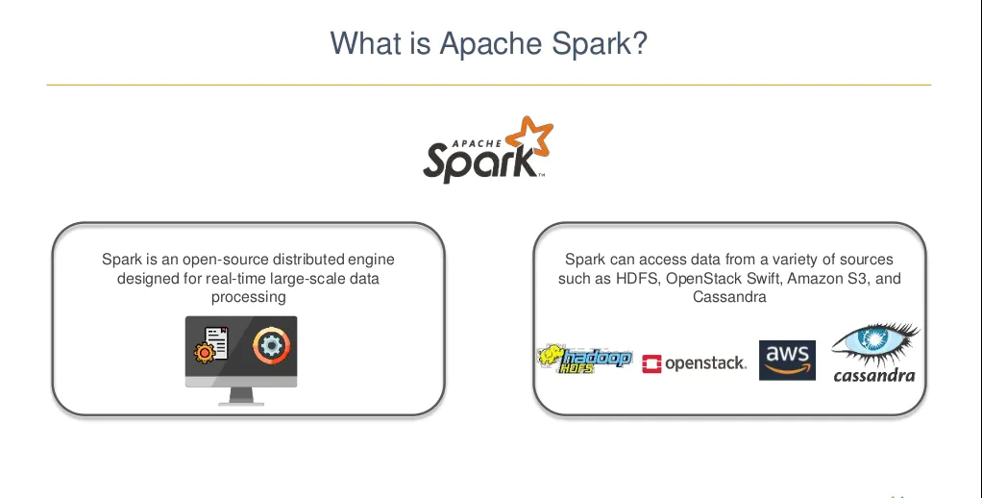

Slide 5
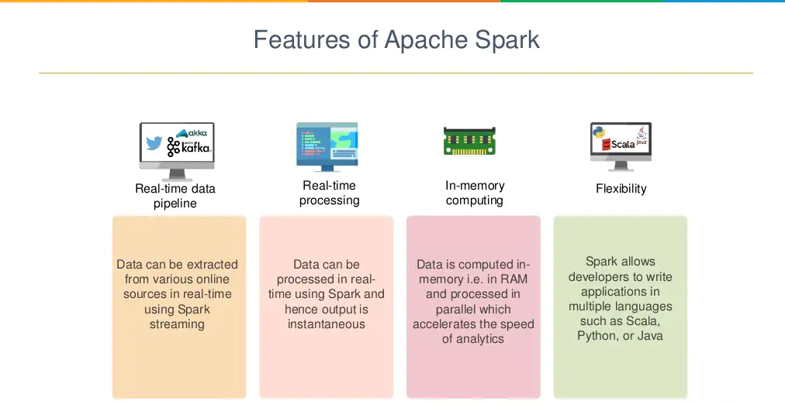

Slide 6
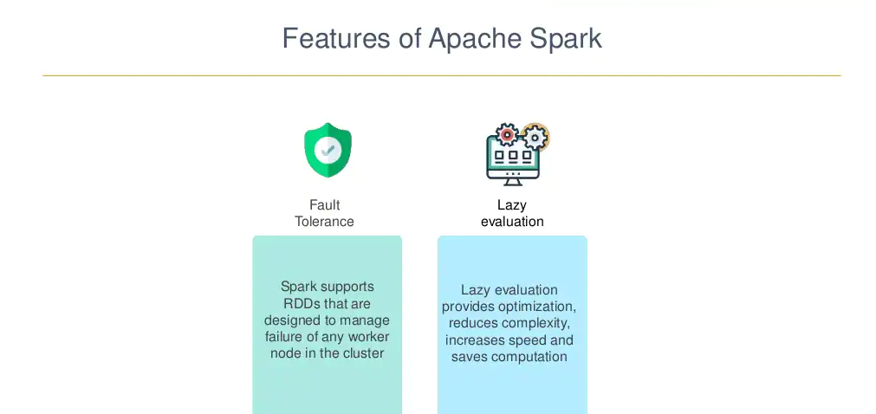

Slide 7
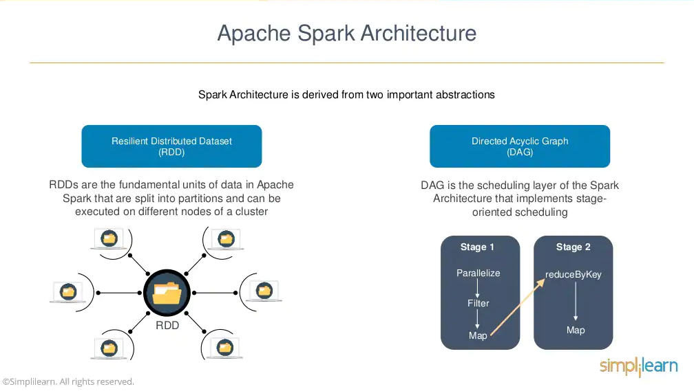

Slide 8
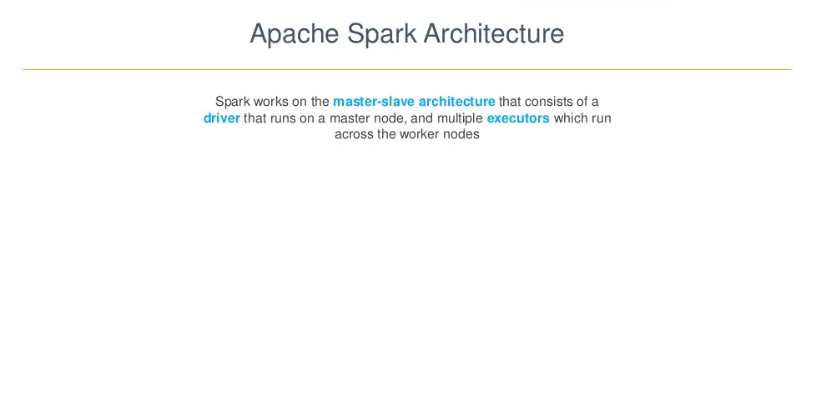
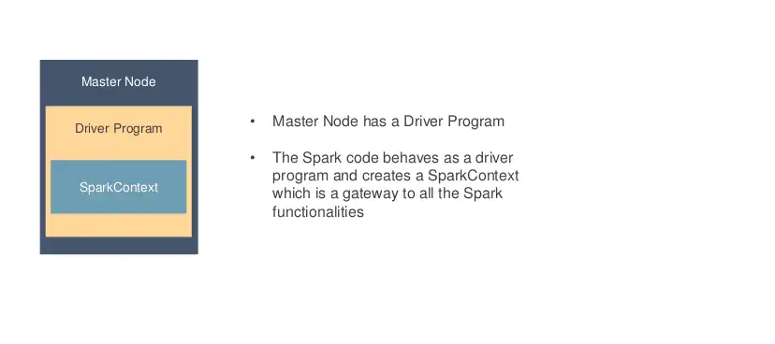

Slide 9
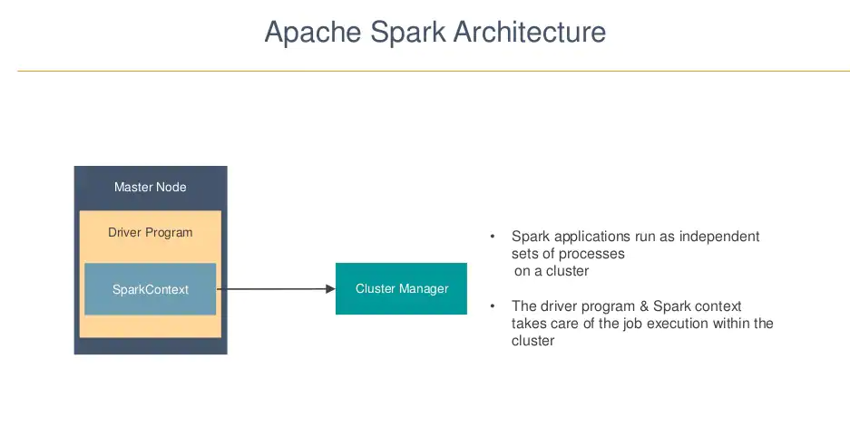

Slide 10
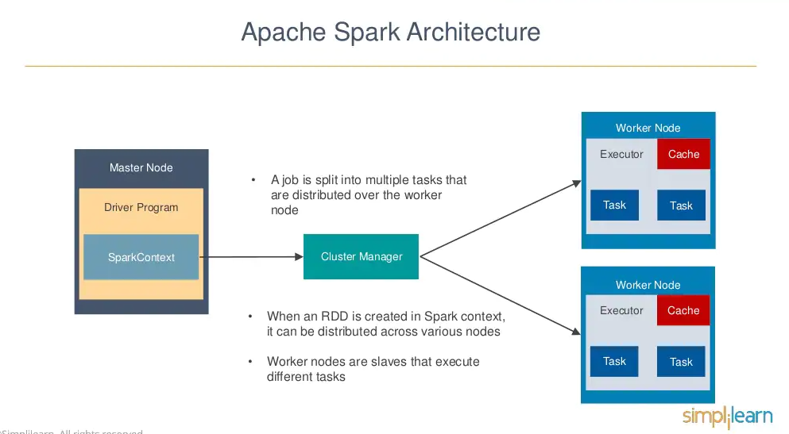

Slide 11
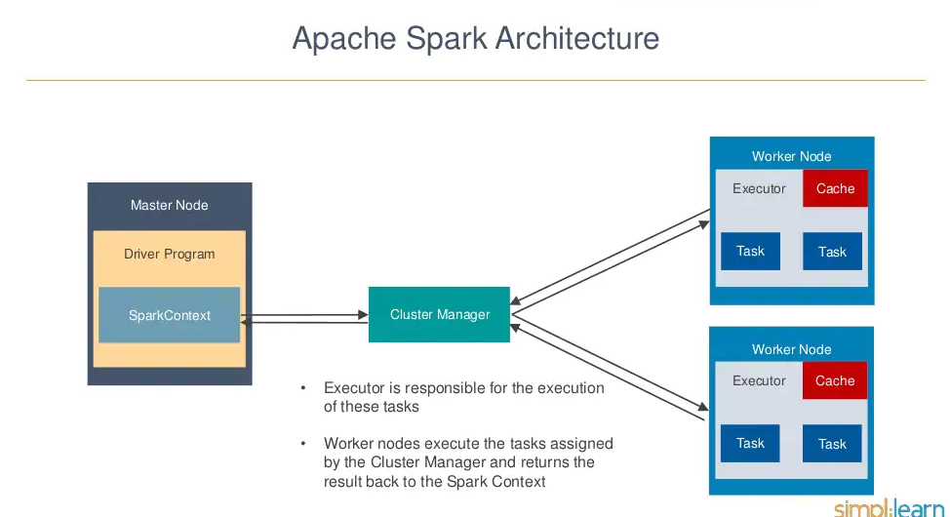

Slide 12
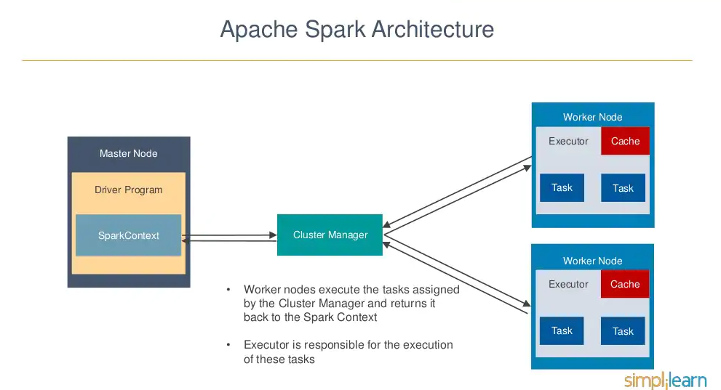

Slide 13
PySpark RDD(Resilient Distributed Dataset)
RDDs are most essential part of the PySpark or we can say backbone of PySpark. It is one of the fundamental schema-less data structures, that can handle both structured and unstructured data. It makes in-memory data sharing 10 - 100x faster in comparison of network and disk sharing.
One of the important advantages of RDD is fault tolerance, it means if any failure occurs it recovers automatically.
The benefit of dividing data into smaller chunks is that if one executor node fails, another node will still process the data. These are able to recover quickly from any issues as the same data chunks are replicated across multiple executor nodes.

Slide 14
Resilient Distributed Datasets (RDDs
Resilient Distributed Datasets (RDDs)
RDDs are the building blocks of any Spark application. RDDs Stands for:
Resilient: It is fault tolerant and is capable of rebuilding data on failure.
Distributed: Data is distributed among the multiple nodes in a cluster.
Dataset: Collection of partitioned data with values.

Slide 15
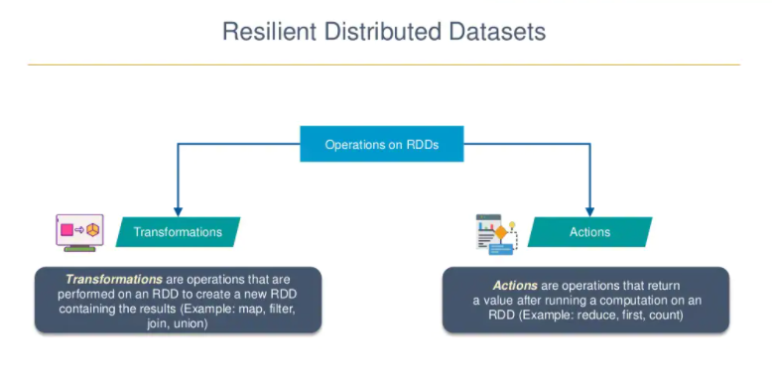

Slide 16
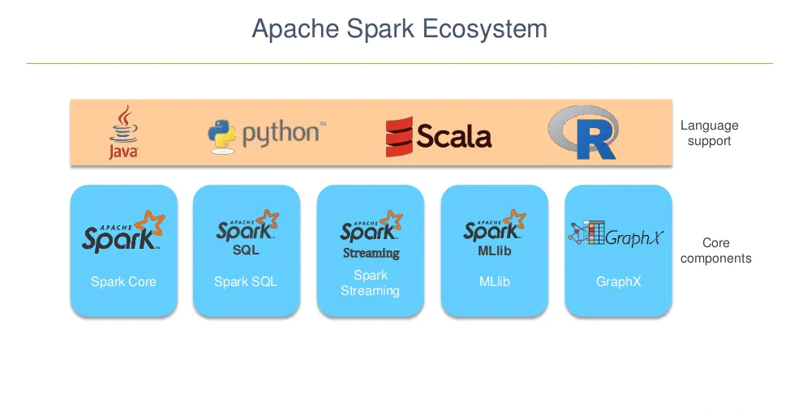

Slide 17
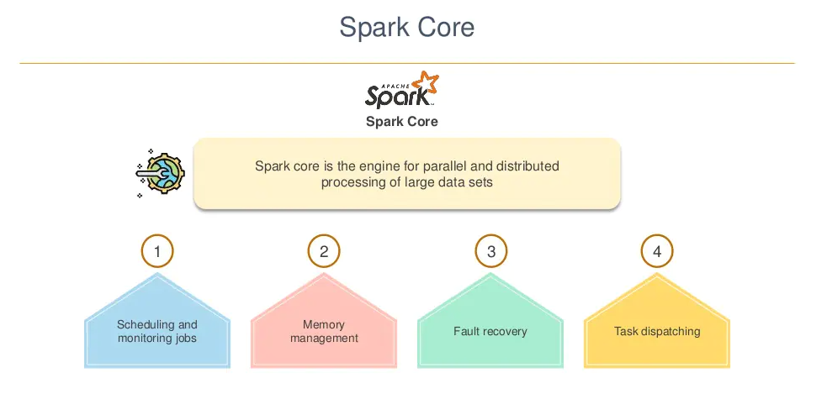

Slide 18
DataFrame:
DataFrame in PySpark is the distributed collection of structured or semi-structured data. This data in Dataframe is stored in rows under named columns which is similar to the relational database tables or excel sheets.
PySpark Streaming:
In this, Spark Streaming receives a continuous input data stream from sources like Apache Flume, Kinesis, Kafka, etc.
These streamed data are then internally broken down into multiple smaller batches based on the batch interval and forwarded to the Spark Engine.
Spark Engine processes these data batches using complex algorithms expressed with high-level functions like map, reduce, join Once the processing is done, the processed batches are then pushed out to databases, filesystems and live dashboards

Slide 19
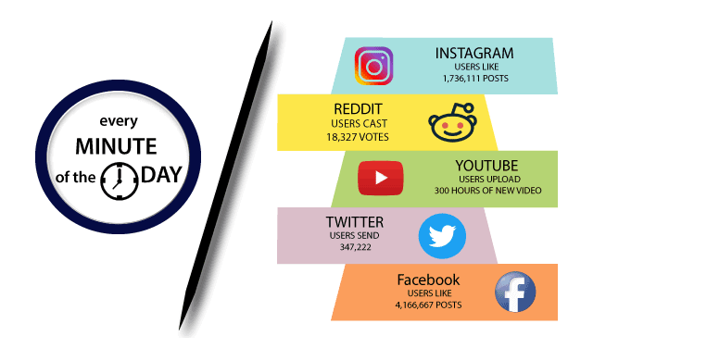
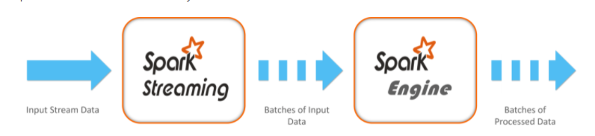

Slide 20
PySpark SQL
PySpark SQL is a higher-level abstraction module over the PySpark Core. It is majorly used for processing structured and semi-structured datasets.
It also provides an optimized API that can read the data from the various data source containing different files formats.
Thus, with PySpark you can process the data by making use of SQL as well as Hive,impala. Because of this feature, PySparkSQL is slowly gaining popularity among database programmers and Apache Hive users.

Slide 21
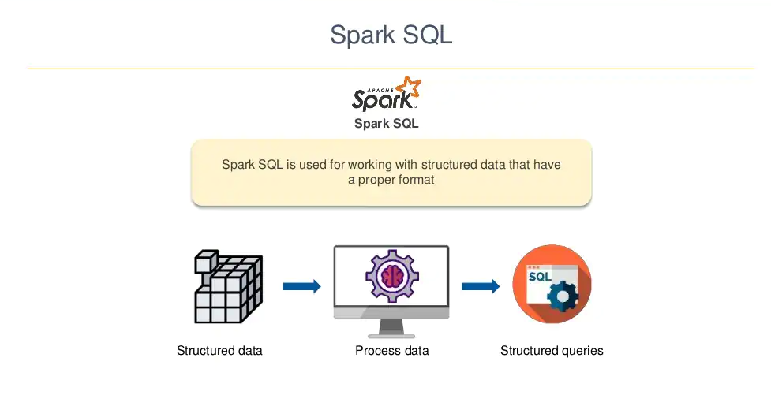

Slide 22
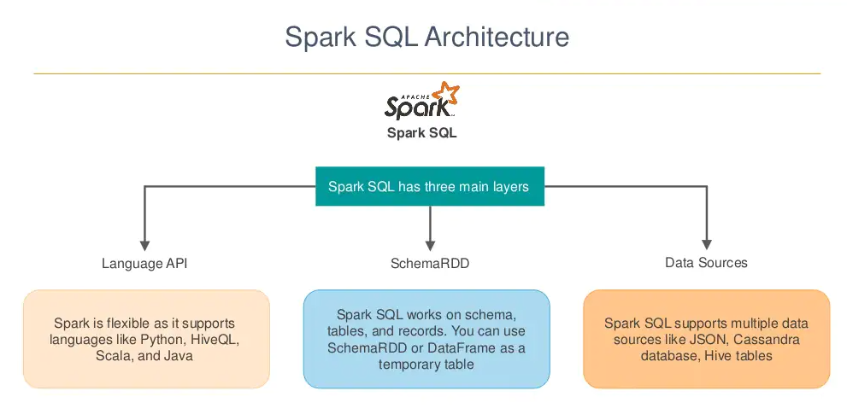

Slide 23
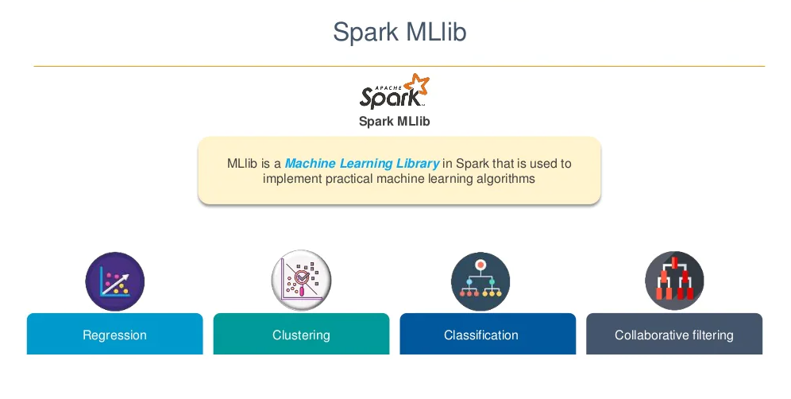
Spark MLlib

Slide 24
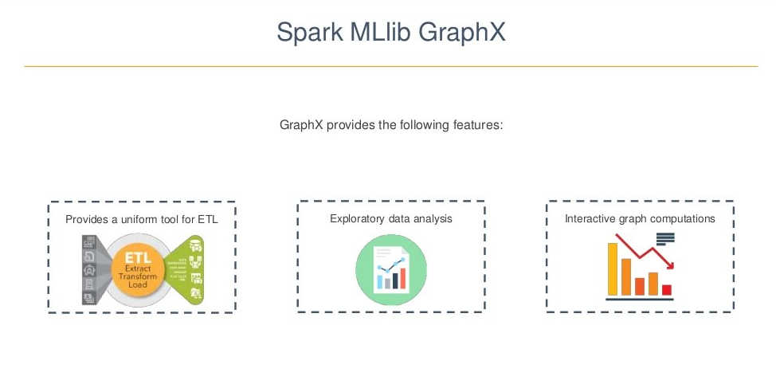

Slide 25
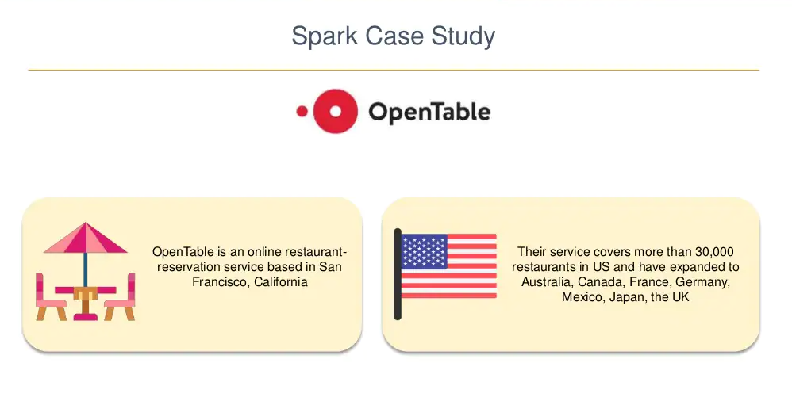

Slide 26
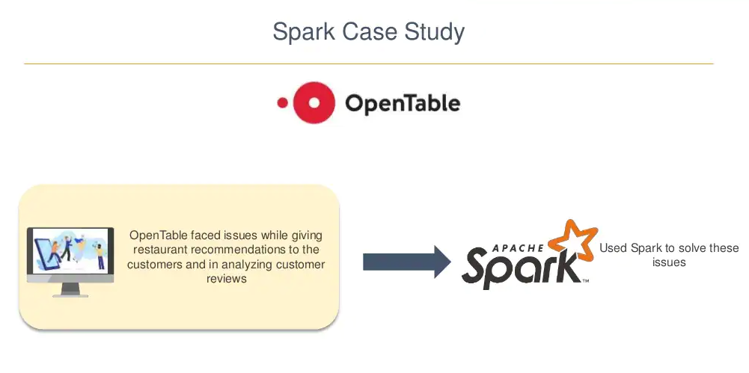

Slide 27
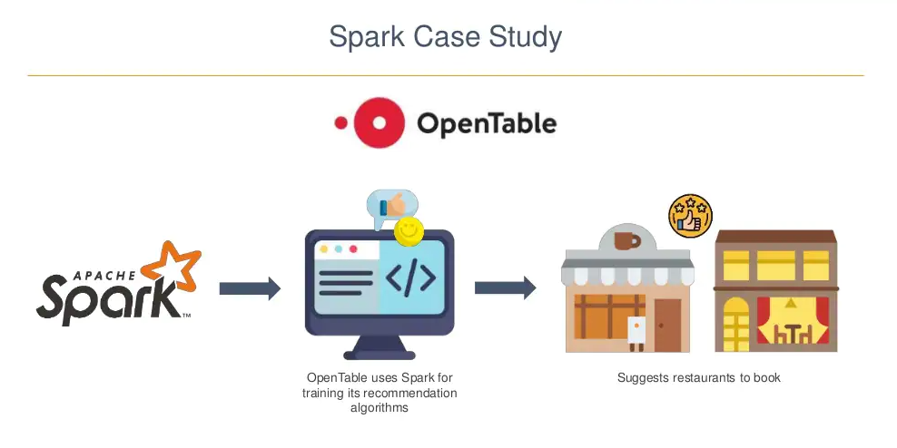

Slide 28
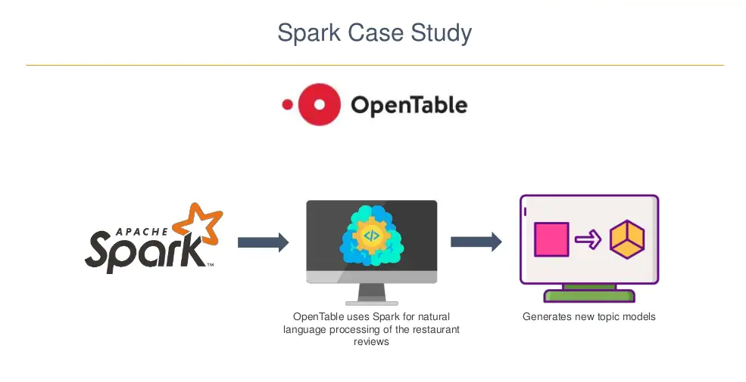

Slide 29
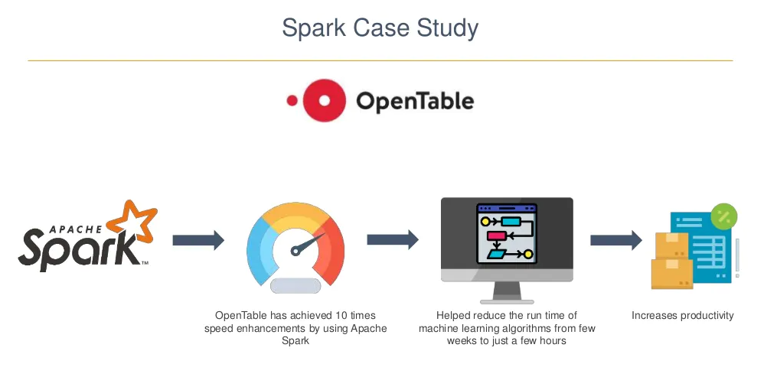

Slide 30
Real-life usage of PySpark
1. Entertainment Industry
The entertainment industry is one of the largest sectors which is growing towards online streaming. The popular online entertainment platform Netflix uses the Apache spark for real-time processing to personalized online movies or web series to its customers. It processes approx. 450 billion events per day that are streamed on server-side application.
2. Commercial Sector:
The commercial sector also uses Apache Spark's Real-time processing system. Banks and other financial fields are using Spark to retrieve the customer's social media profile and analyze to gain useful insights which can help to make the right decision.
The extracted information is used for the credit risk assessment, targeted ads, and customer segmentation.
Spark plays a significant role in Fraud Detection and widely used in machine learning tasks

Slide 31
3. Healthcare
Apache Spark is used to analyze the patient records along with the previous medical reports data to identify which patient is probable to face health issues after being discharged from the clinic.
4. Trades and E-commerce
The leading e-commerce websites like Flipkart, Amazon, etc, use Apache Spark for targeted advertising. The other websites such as Alibaba provides targeted offers, enhanced customer experience and optimizes overall performance.
5. Tourism Industry
The tourism industry widely uses Apache Spark to provide advice to millions of travelers by comparing hundreds of tourism websites.
In this tutorial, we have learned about the PySpark introduction, we will learn more about PySpark in the further tutorial

Slide 32
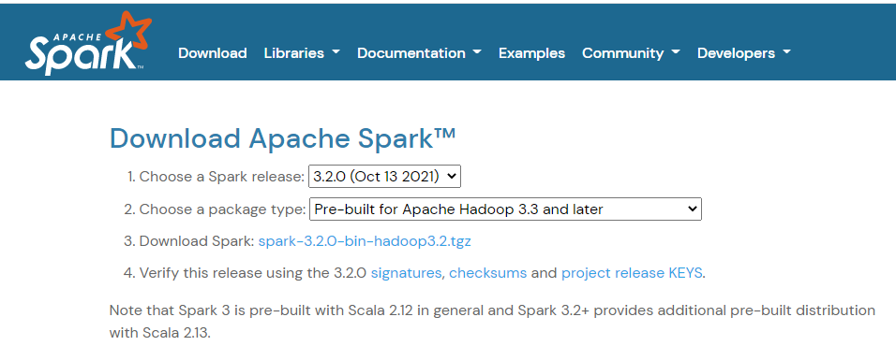
How to Install and Run PySpark in Jupyter Notebook on Windows
1) Downlode Apache Spark

Slide 33
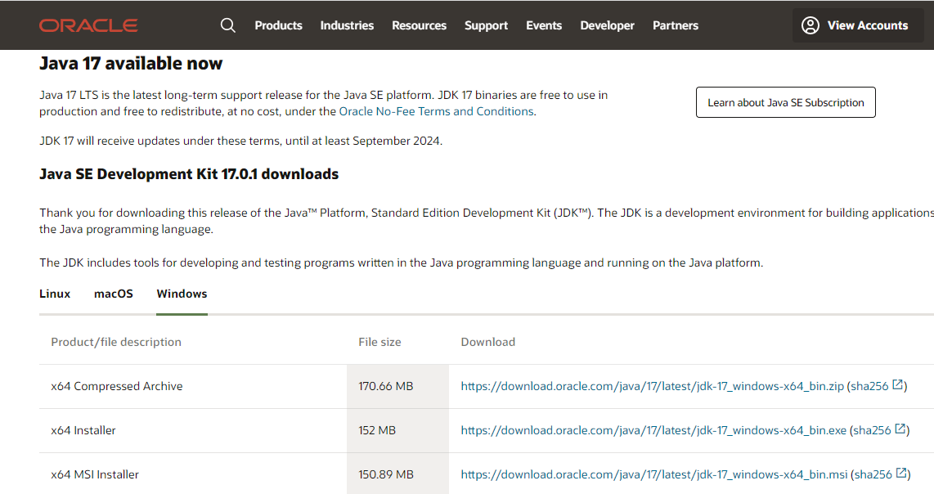
2) Downlode java jdk

Slide 34
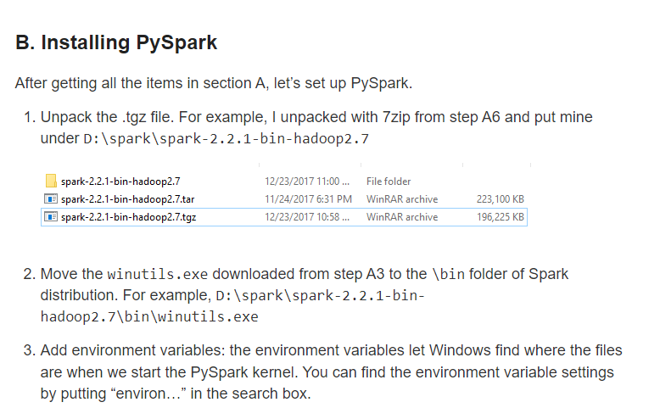

Slide 35
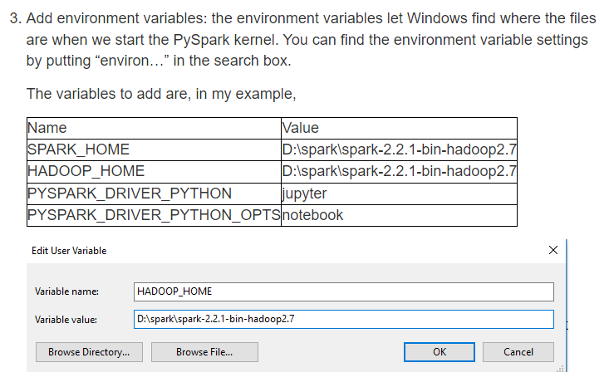

Slide 36
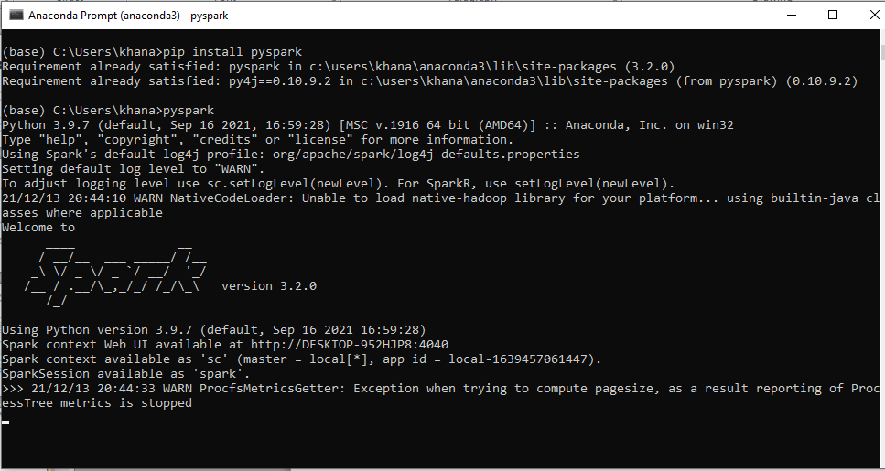
Running PySpark in Jupyter Notebook

Slide 37
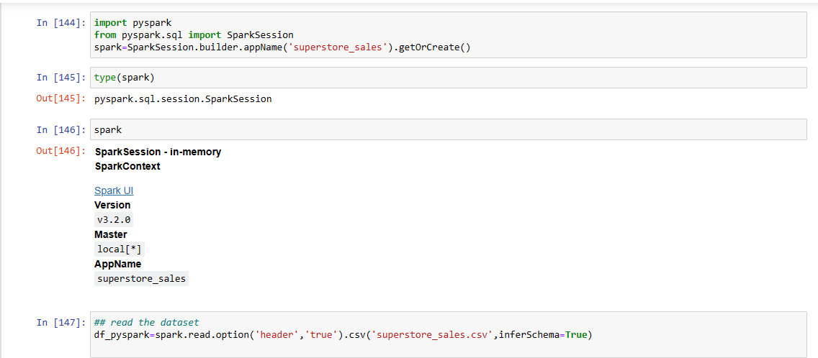
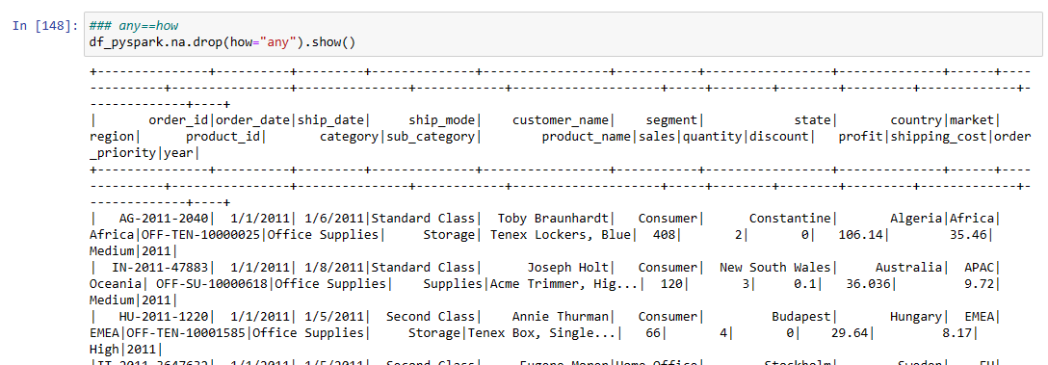

Slide 38


Slide 39
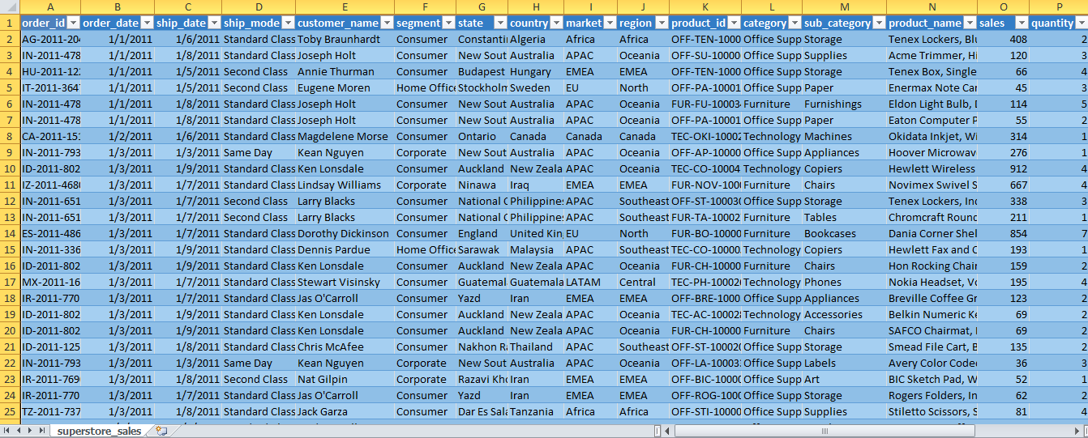
Super_store dataset

Slide 40
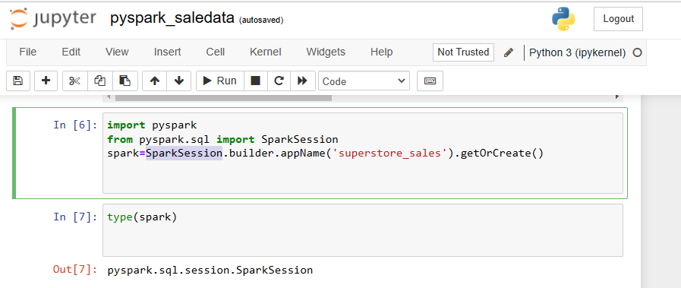
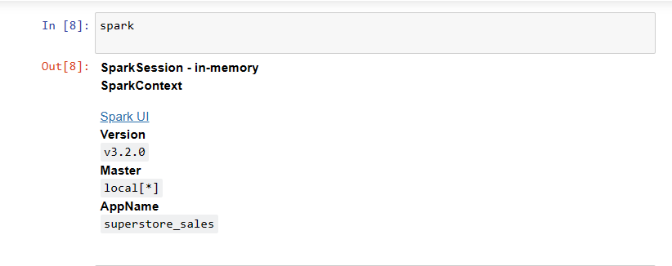
Creat SparkSession in jupyter

Slide 41
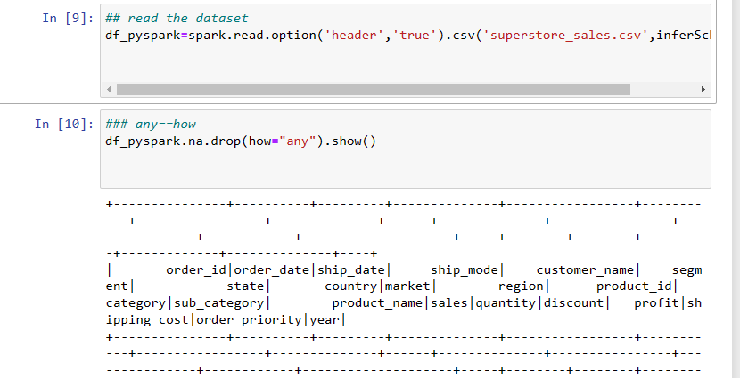
## read the dataset
df_pyspark=spark.read.option('header','true').csv('superstore_sales.csv',inferSchema=True)

Slide 42
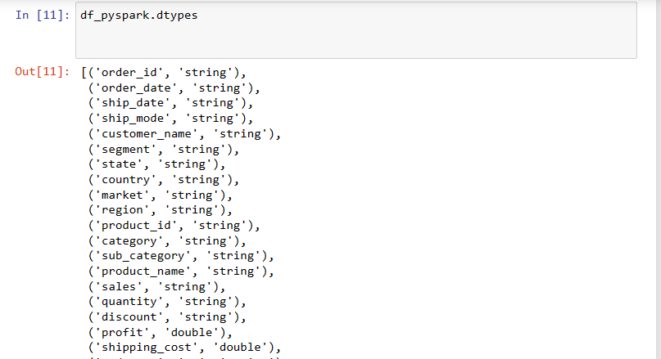
Show data types of dataset in spark

Slide 43
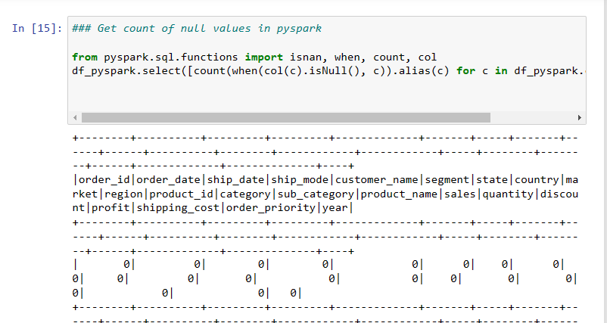
Count of null values in spark

Slide 44
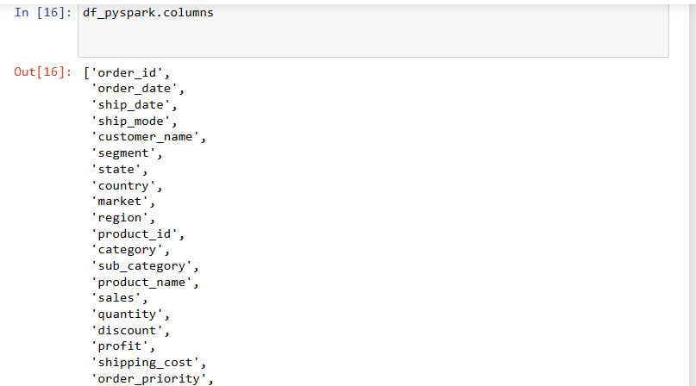
How many columns in data

Slide 45
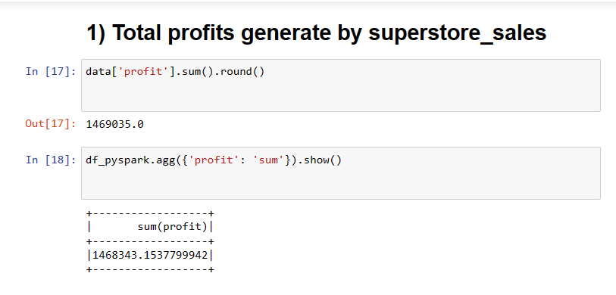

Slide 46
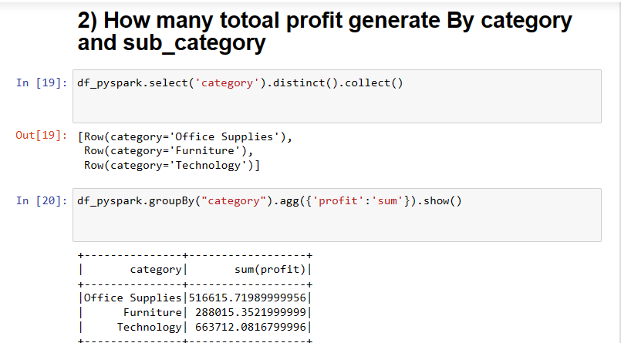

Slide 47
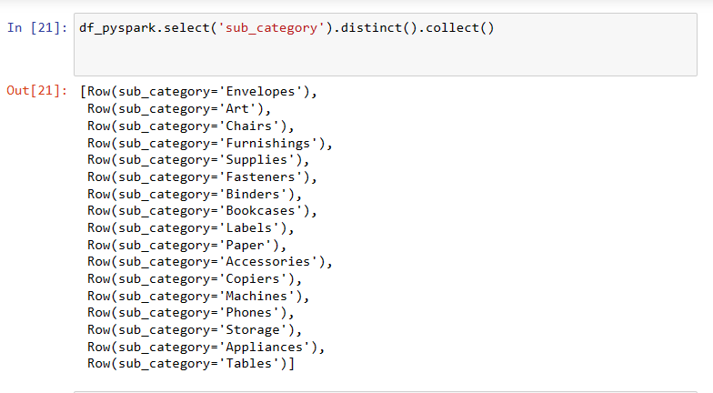

Slide 48
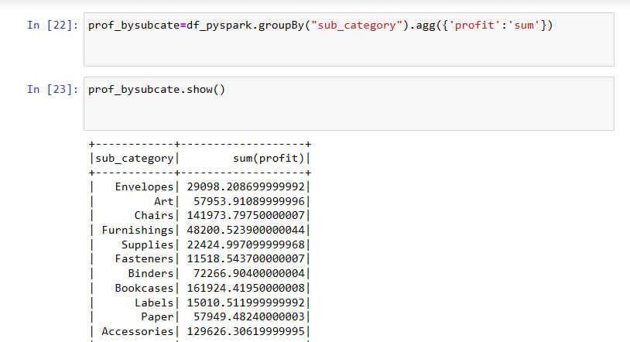

Slide 49
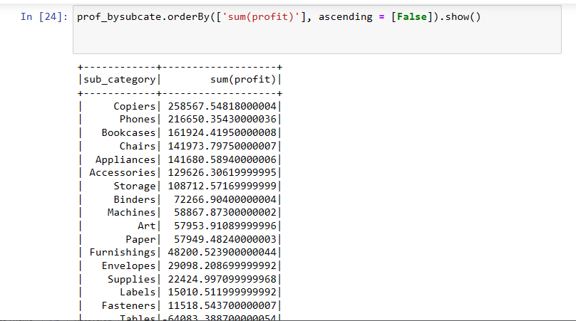
Total profit generate by sub_cate

Slide 50
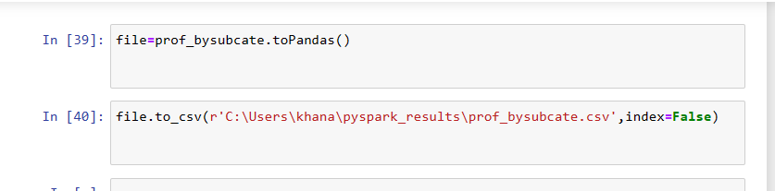
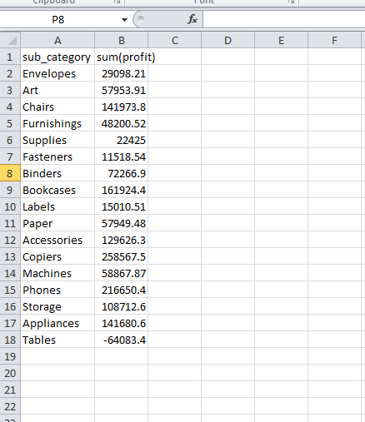
Save result of data in file

Slide 51
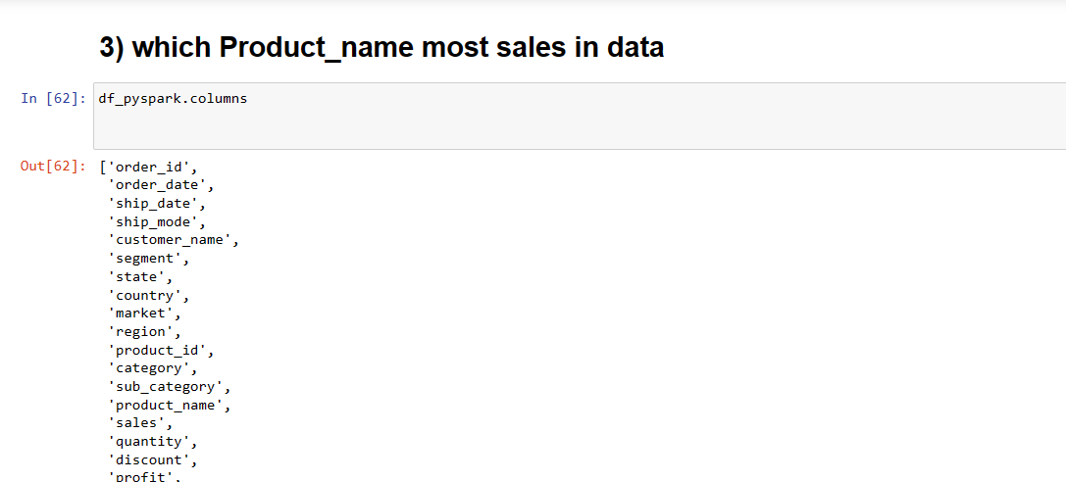

Slide 52
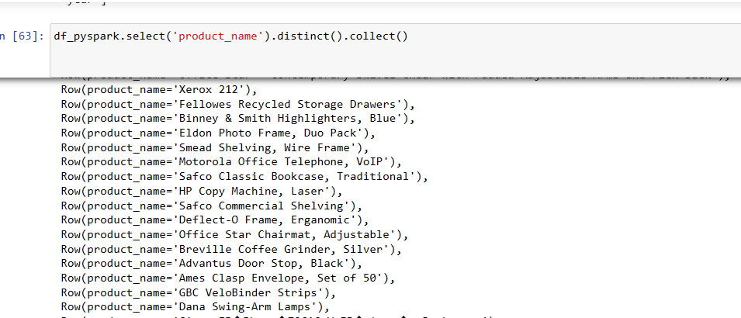
Distinct by product name

Slide 53
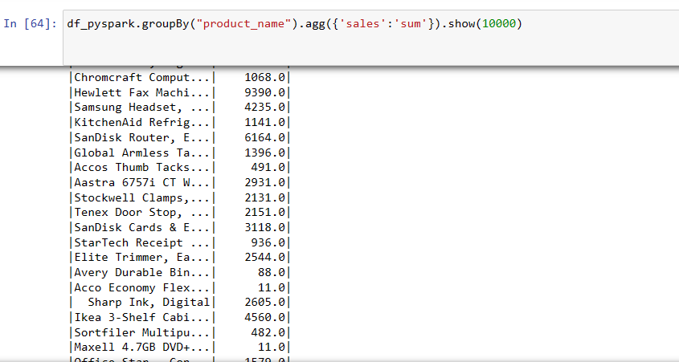
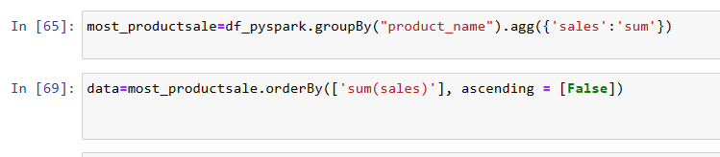

Slide 54
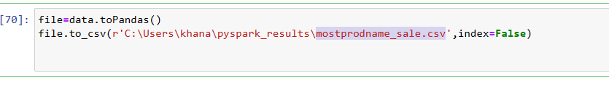

Save result of mostprodname_sale.csv

Slide 55

Top 20 most product sale

Slide 56

Which customers most sale

Slide 57


Slide 58



Slide 59

Save sum(sales) of data in file

Slide 60

Top 20 customer

Slide 61

Which region most sale

Slide 62

Which country most sale

Slide 63



Slide 64

Top 20 country who most product sale

Slide 65


Slide 66



Slide 67



Slide 68


Slide 69



Slide 70

Save result of united state in csv file

Slide 71


Slide 72



